Slide 1
Hello and Welcome to

Slide 2
Mesquite, Nevada
Mesquite Nevada,
80 miles north of Las Vegas, approximately an hour and fifteen minute scenic drive from McCarran Airport.
Located on the border of Arizona, Utah and Nevada in the lovely
Virgin River Valley. Surrounded by towering mountains and spectacular Red Rock Mesas.
Mesquite is a jewel in the desert .

Slide 3
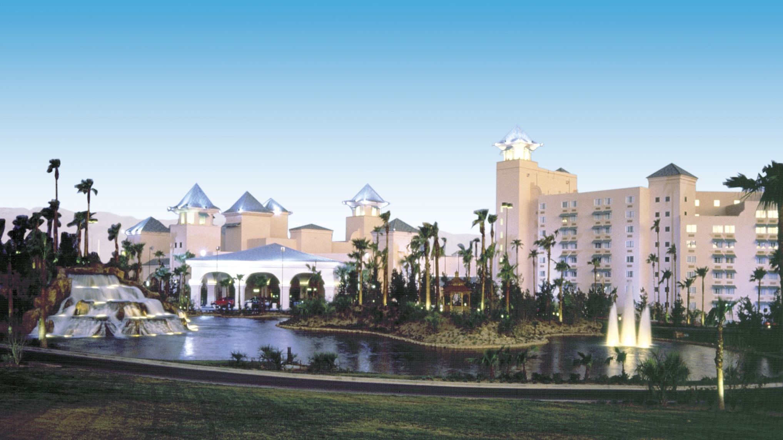

Slide 4
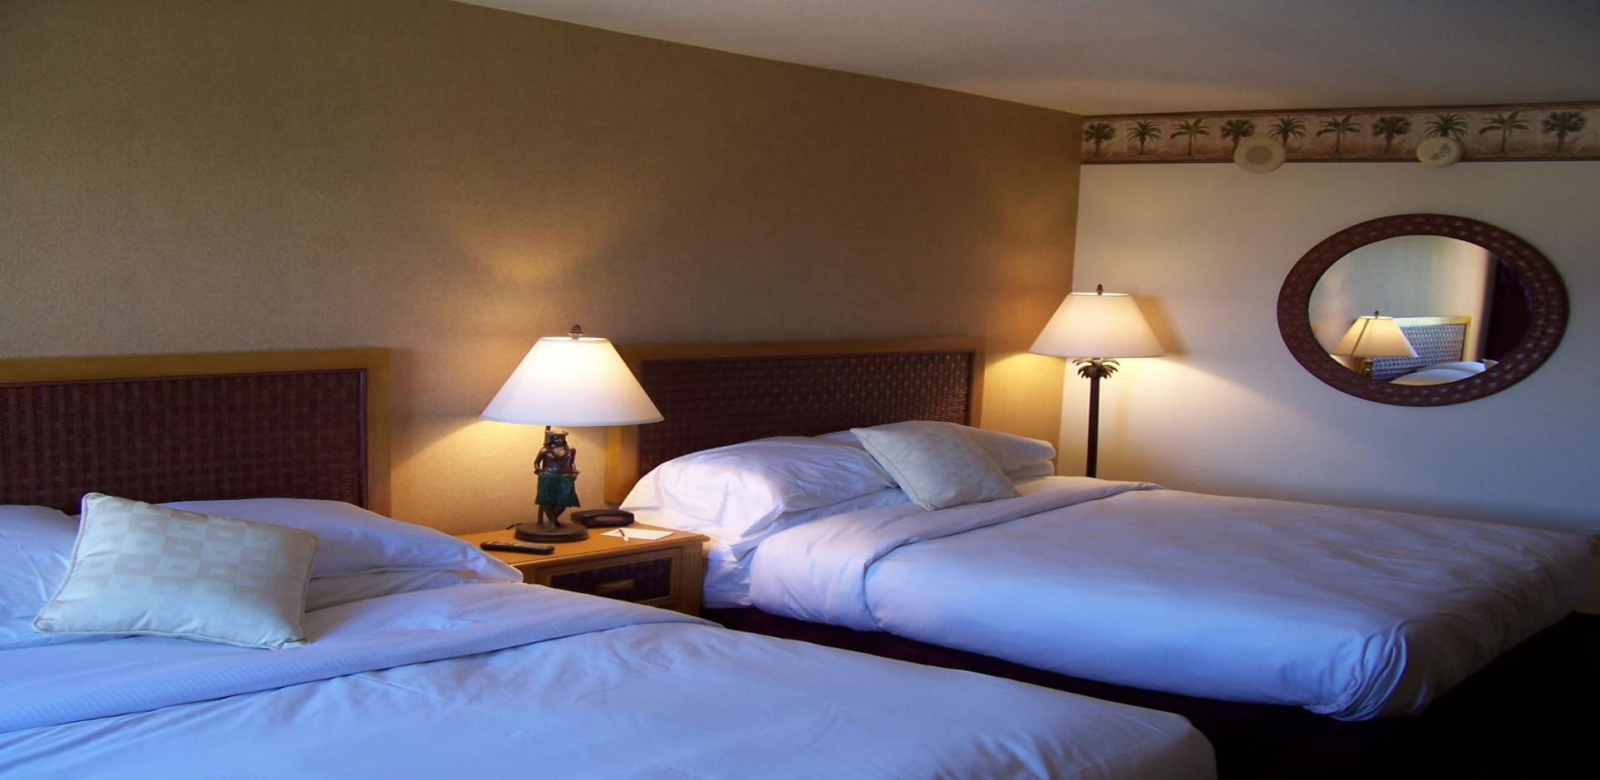
Deluxe European Style Bedding

Slide 5
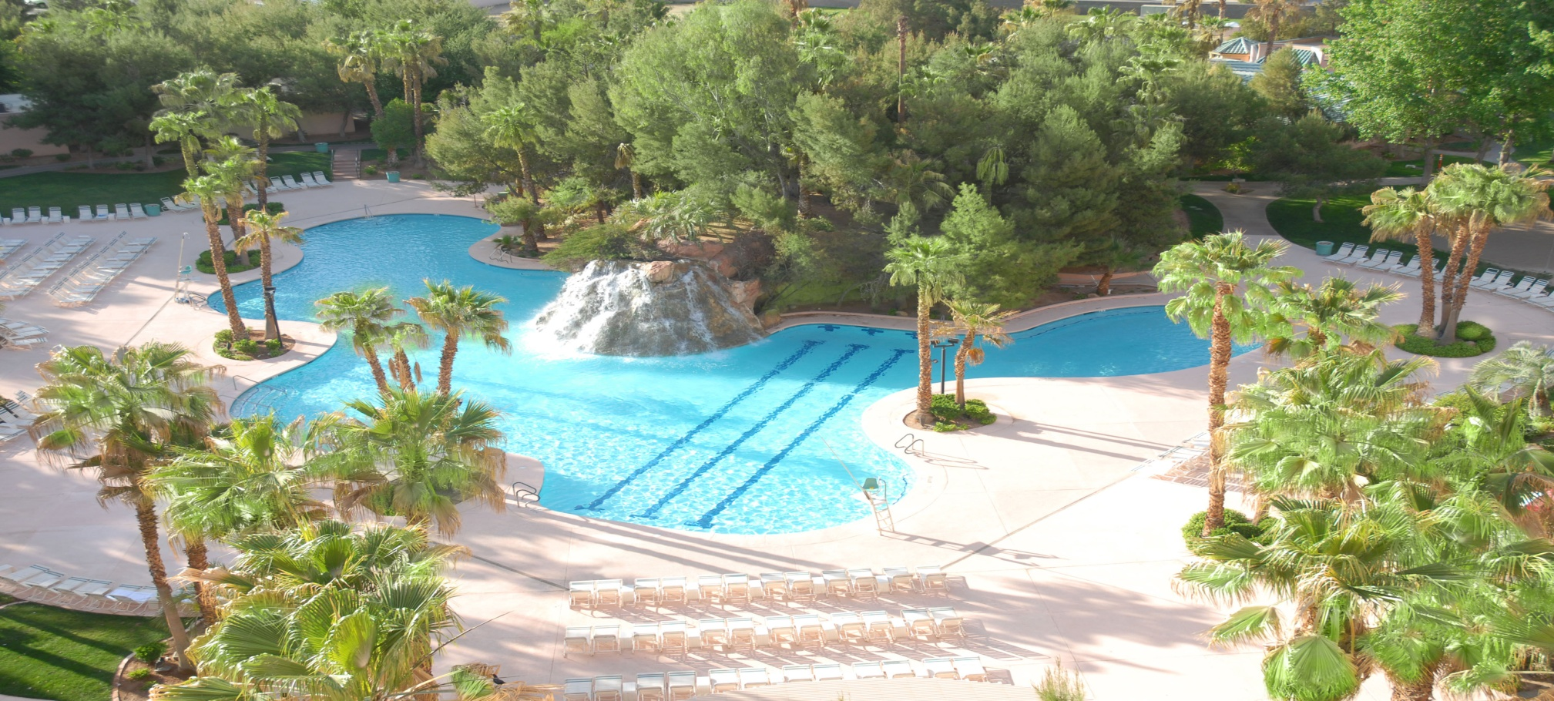
Lagoon Pool with water slide

Slide 6
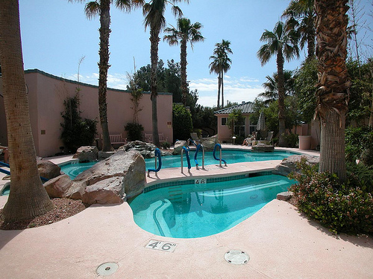
Relax in the
Mineral Pool
or treat yourself to one of our fabulous massage or facials!

Slide 7
For your Dining Pleasure
Katherine’ s Fine Dining – Steaks and Seafood

Slide 8
For your Dining Pleasure
The Smorgasbord
Better than a buffet
With live action stations
Open Friday – Sunday

Slide 9
For your Dining Pleasure
The Fez
Open 24 hours/7days a week
Extensive menu
Try the special Barbecue Selections!

Slide 10
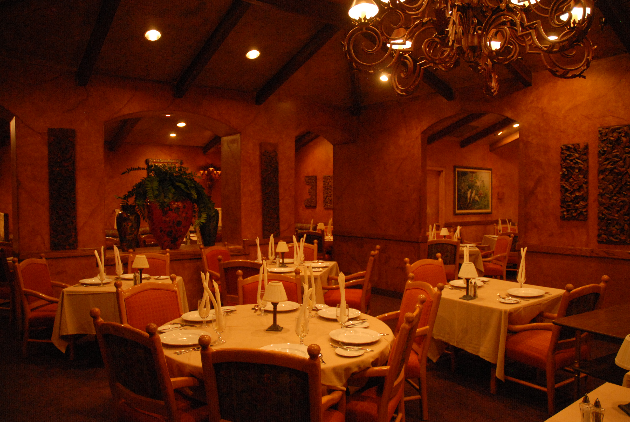
For the smaller appetite

Slide 11
Gaming!

Slide 12
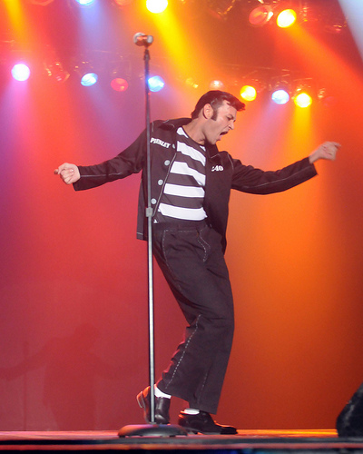
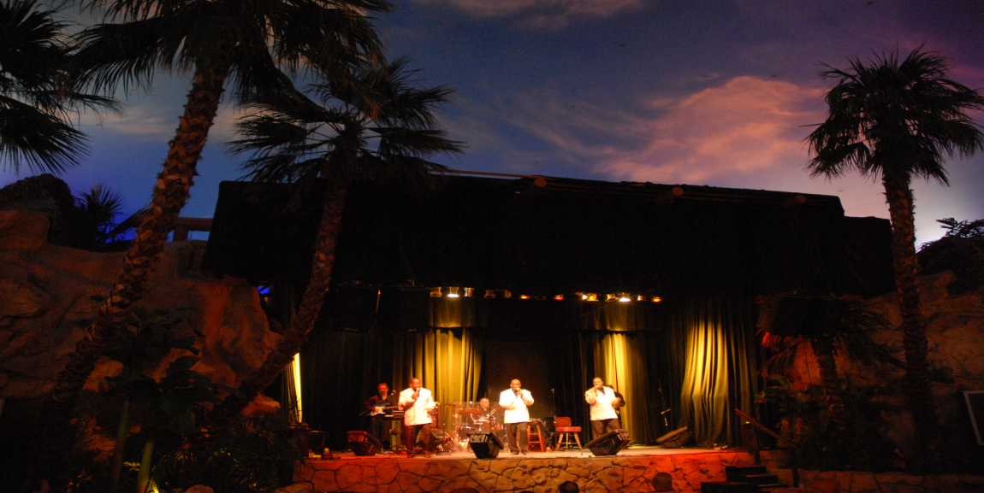
Entertainment

Slide 13
Featuring 500 deluxe rooms featuring European style bedding. Tower rooms and lagoon suites that open to the pool.
Casino with all your favorite table games and slot machines. Live Sports Bar action!
The CasaBlanca Spa with all the newest techniques and treatments
Tropical Lagoon Pool with slide and waterfall
Katherine’s Steak House – Fine Gourmet Dining
And much, much more!

Slide 14
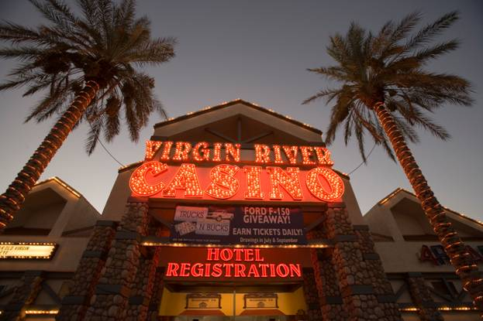
Virgin River Hotel – Casino - Bingo

Slide 15
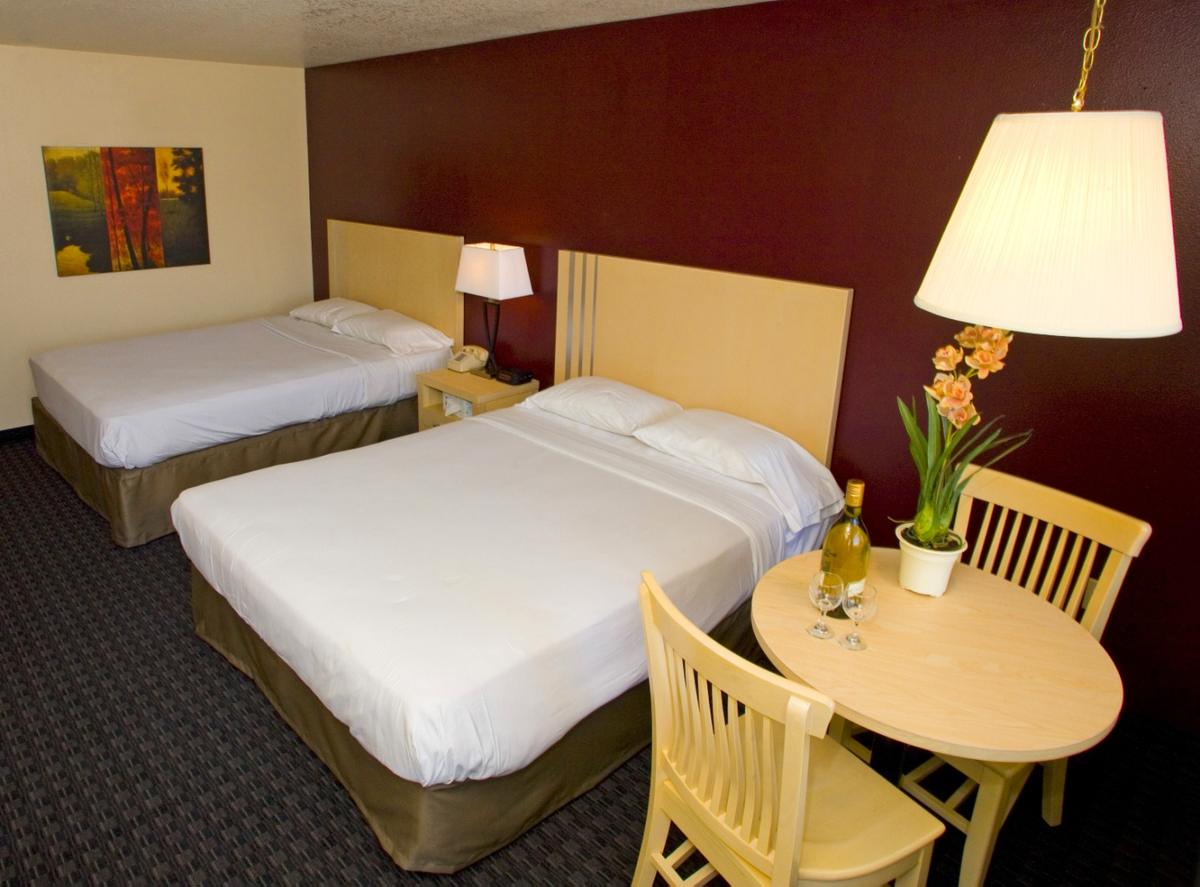
Freshly, remodeled rooms

Slide 16
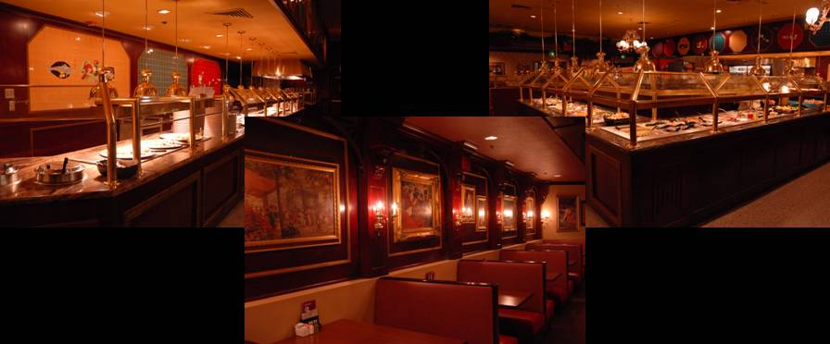
Sierra’s Buffet
Voted #1 Buffet in Mesquite

Slide 17
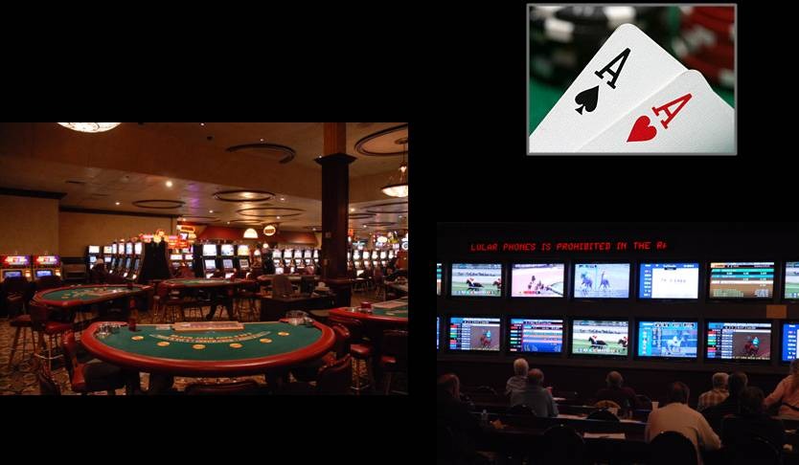
24-Hour Casino Action
Race & Sports Book

Slide 18
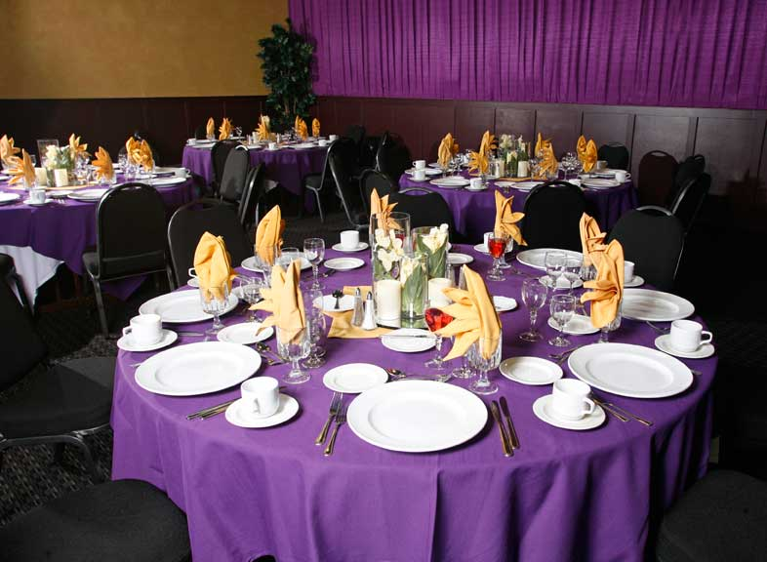
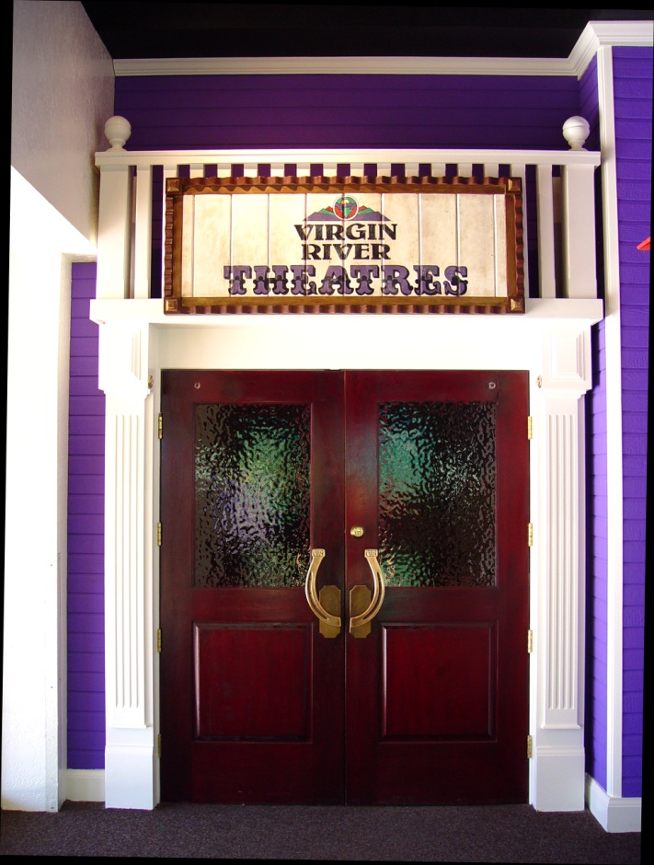
New Banquet Area

Slide 19
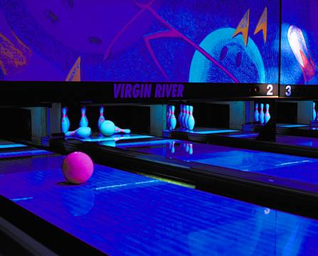
24-Lane Bowling Center

Slide 20
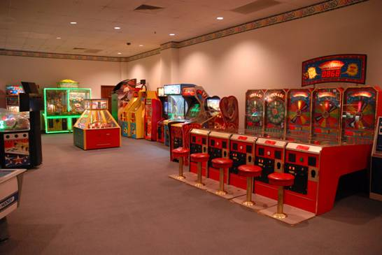
Virgin River Arcade

Slide 21
Virgin River Hotel - Casino
Seven buildings, 3 floors in each – 722 total rooms, most with two Queen size beds
103,000 Square foot Casino with all your favorite table games and slot machines
Live Keno and Race and Sports Book and BINGO
Starbucks!

Slide 22
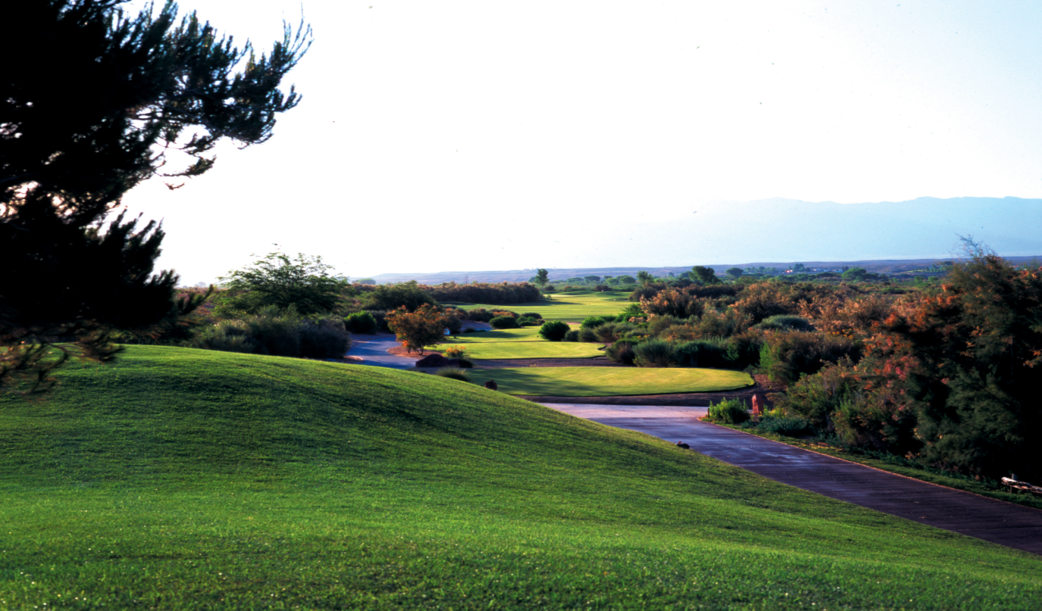
CasaBlanca Golf Course

Slide 23
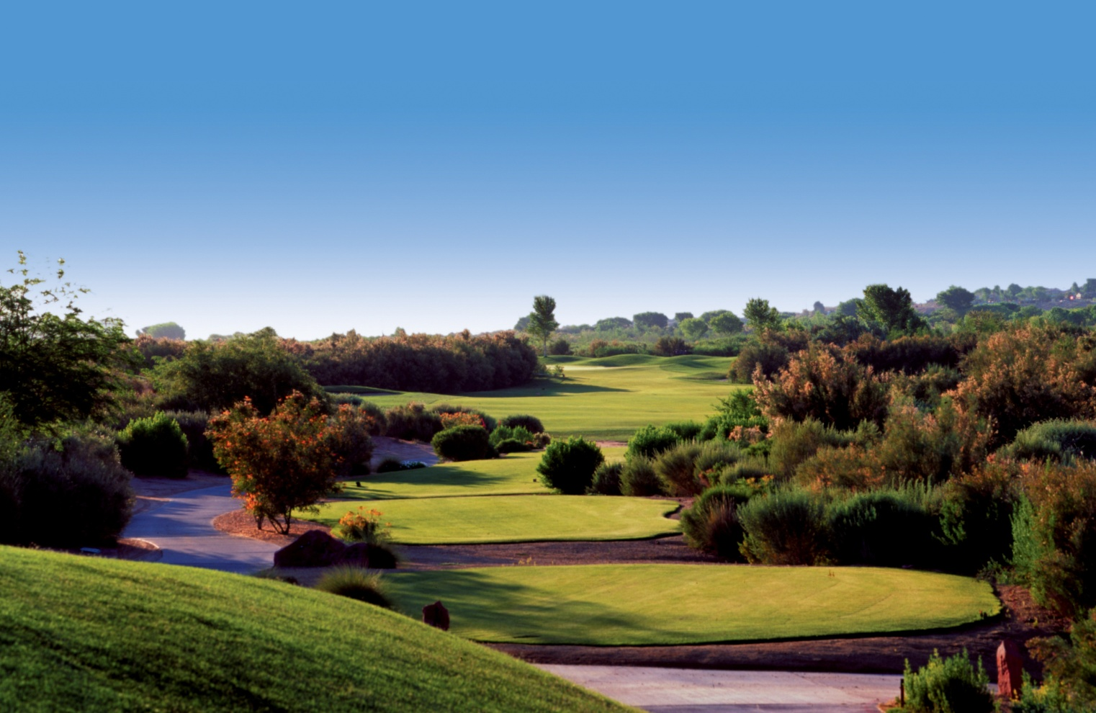
CasaBlanca Golf Course

Slide 24
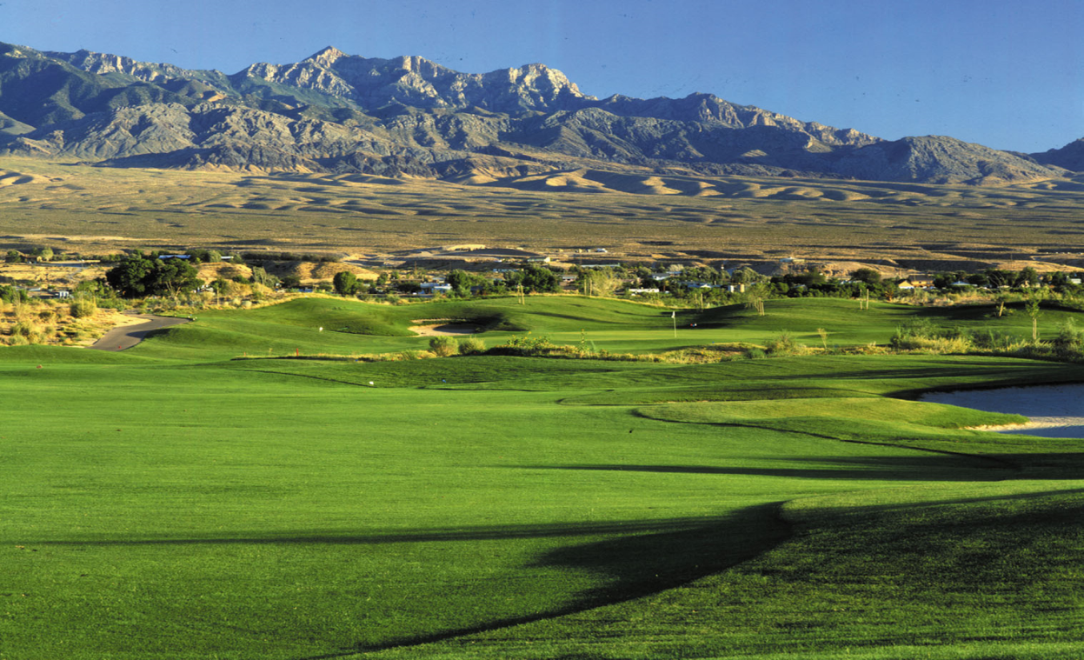
CasaBlanca Golf Course

Slide 25
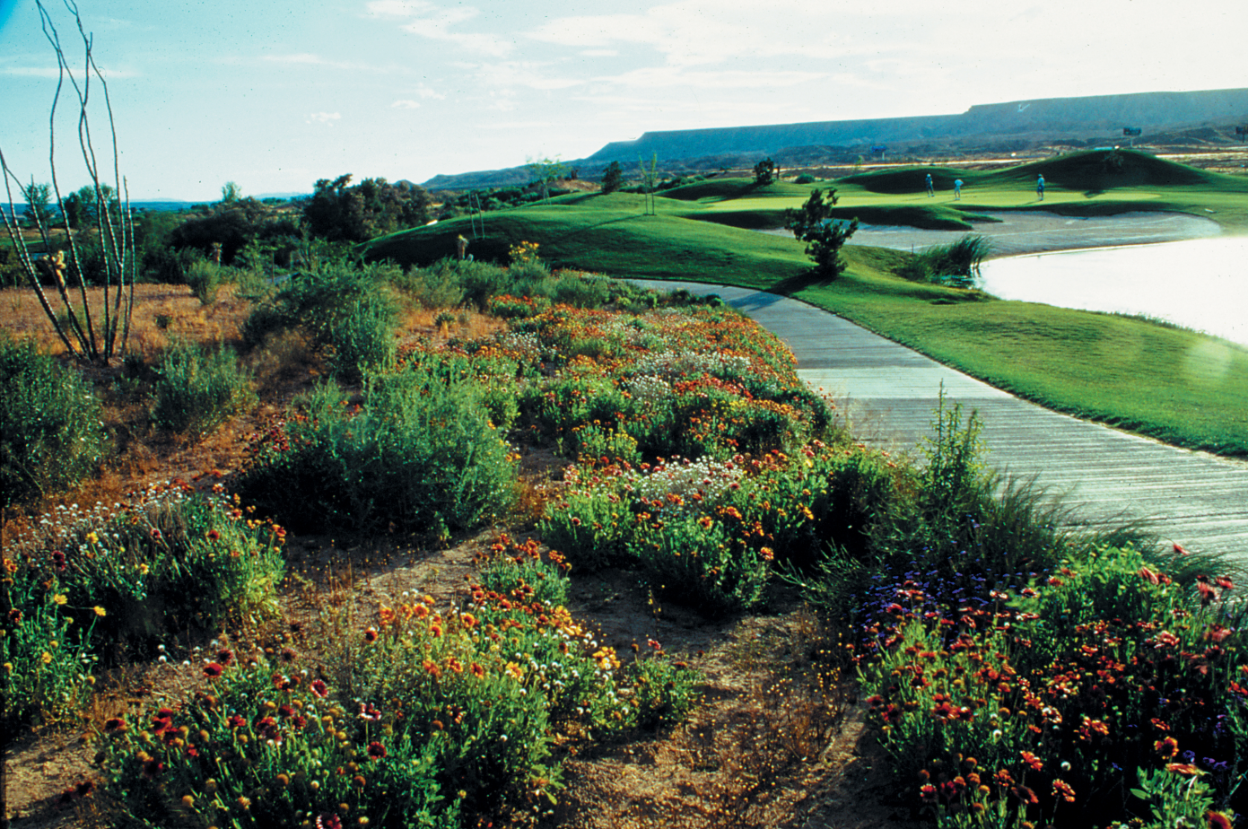
CasaBlanca Golf Course

Slide 26
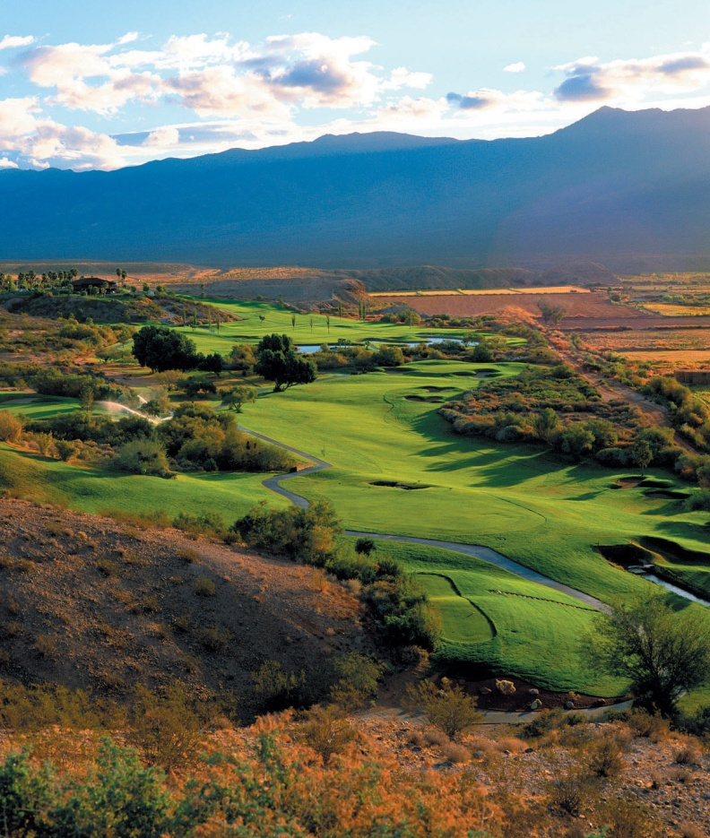
Palms Golf Club

Slide 27
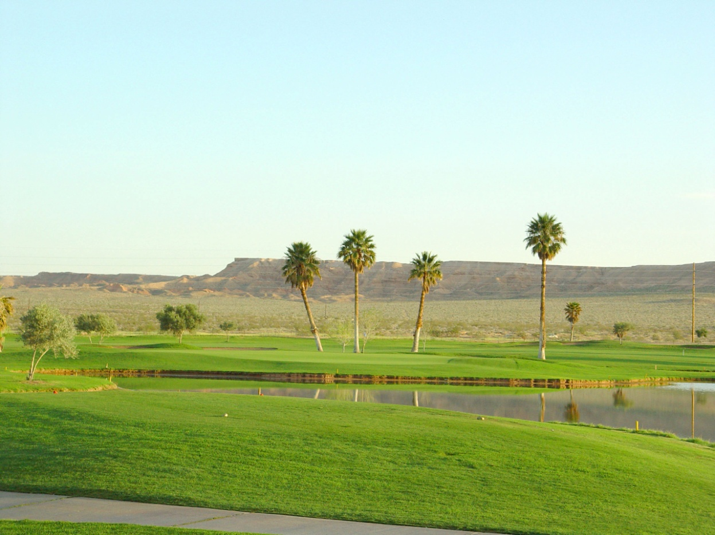
Palms Golf Club

Slide 28
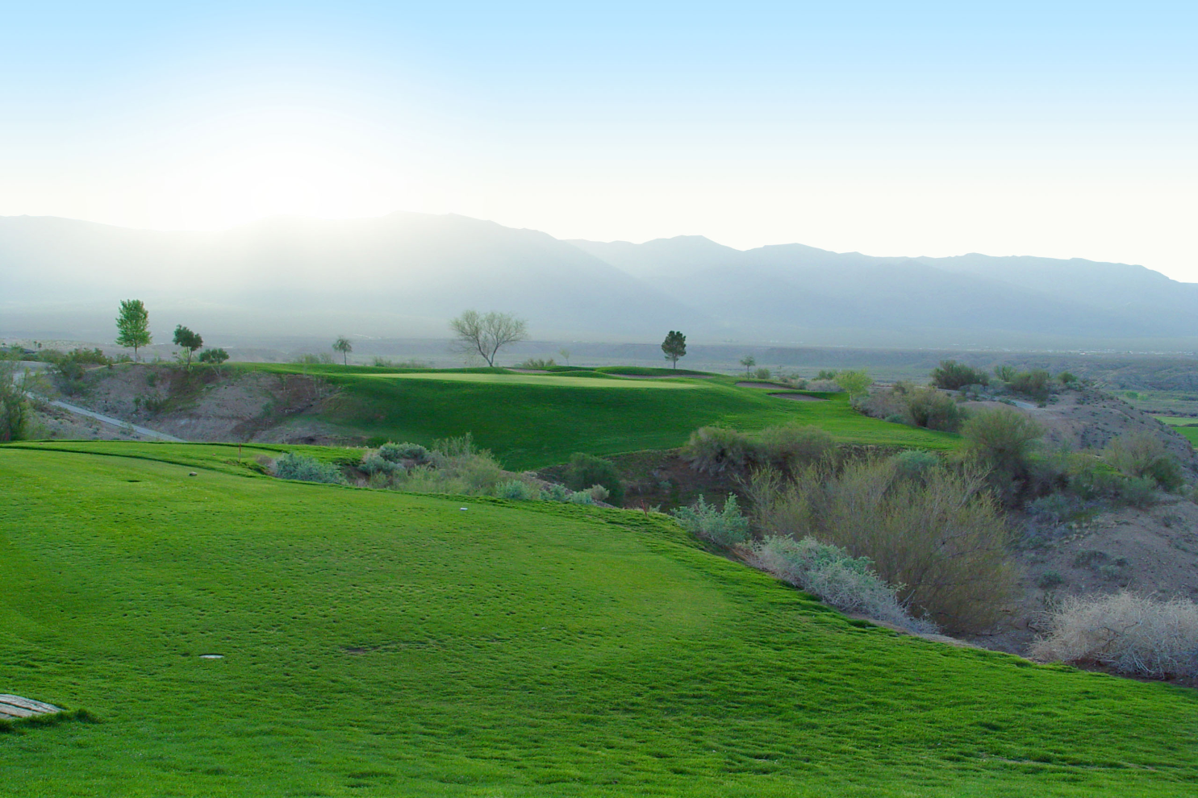
Palms Golf Club

Slide 29
Mesquite, Nevada
Gateway to the Spectacular Canyon Land of Nevada and Southern Utah
Valley of Fire State Park – 52.5 Miles
Zion National Park- 77 Miles
Tuacahn Theatre- 39 Miles
Bryce Canyon National Park- 170 Miles
Grand Canyon North Rim- 180 Miles
Grand Canyon West Rim – 200 Miles

Slide 30
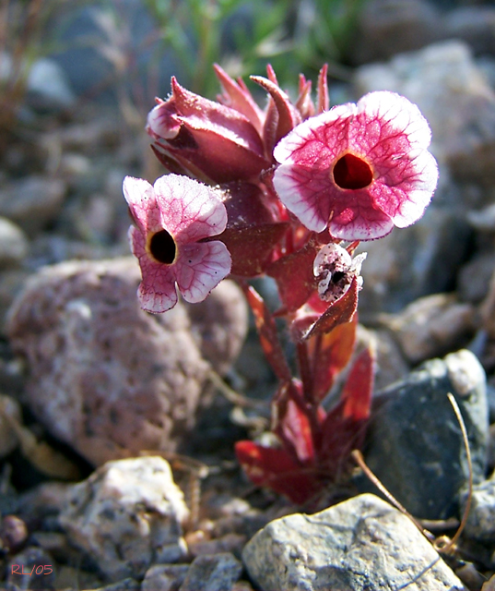
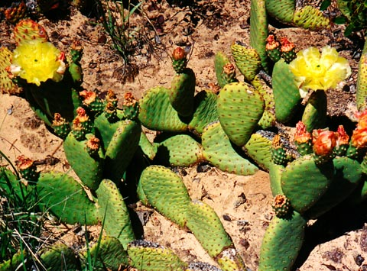
The Flowers of the Desert Southwest

Slide 31
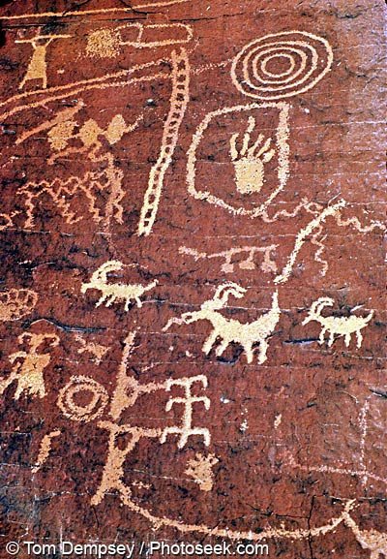
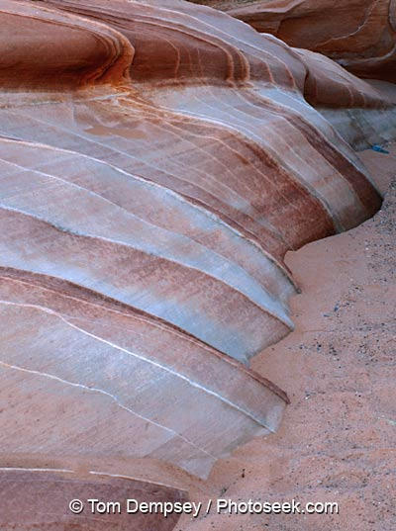
Valley of Fire, Nevada

Slide 32
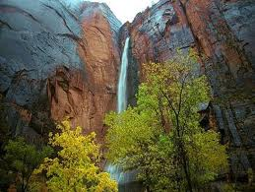
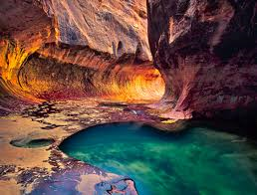
Zion National Park

Slide 33
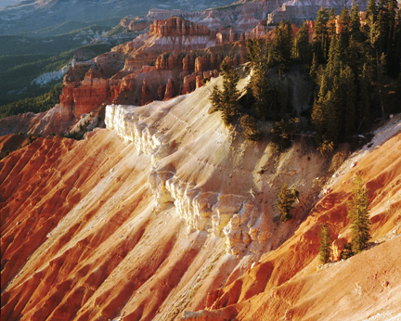
Bryce Canyon, Utah

Slide 34
We look forward to welcoming you to Mesquite!
Bernadette Anthony
888-711-4653 ext. 31
Petra Jones
888-711-4653 ext. 17

